Slide 1
Seeking Failure
Tracy Melvin: swemtrac@msu.edu @TracyMelvin14

Slide 2
Do you have a “how to” for other WiNN chapters? swemtrac@msu.edu

Slide 3
We declare this hour to be a sacred, safe, supportive space. We are here for each other – for all the versions of ourselves we have been and will be, and the self we are at this exact moment.
Notes:
Set the space

Slide 4
Presentation (25 min)
Sharing Circles for Empathizing Experience (15 min)
Open discussion about our fears and lessons learned (20 min)
Notes:
Set the space

Slide 5
This session is about learning from and celebrating each other and giving a platform to understand the experiences of the oppressed.

Slide 6
Sharing circles are safe places to express yourself. We actively listen and support. We thank you for having the courage to speak.
Some suggestions for sharing circles:
Share your current struggles
Past failures
Ways you navigate pain and fear
Pain or struggle you can’t seem to navigate
Platforms for growth (programs, opportunities)

Slide 7
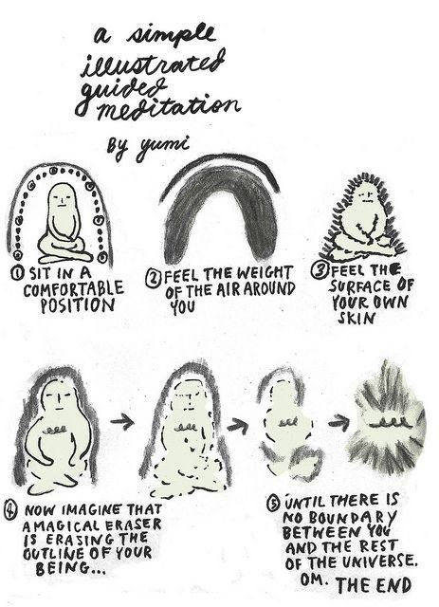

Slide 8
Who has failed?
z

Slide 9
What is failure?
z

Slide 10
Failure
Blissful ignorance?
Navigating grief, pain, shame

Slide 11
Failure
Blissful ignorance?
Navigating grief, pain, shame

Slide 13
Avoiding the unrecoverable failures
(consciousness of self)
Resiliency Skills
(radical empathy)
(growing your onion)
(growing your trusted advisers)
(leading with vulnerable courage)

Slide 14
Avoiding the unrecoverable failures (consciousness of self)
z

Slide 15
So live your life that the fear of death can never enter your heart. Trouble no one about their religion; respect others in their view, and demand that they respect yours. Love your life, perfect your life, beautify all things in your life. Seek to make your life long and its purpose in the service of your people. When it comes your time to die, be not like those whose hearts are filled with the fear of death, so that when their time comes, they weep and pray for a little more time to live their lives over again in a different way. Sing your death song and die like a hero going home. ~ Tecumseh

Slide 16
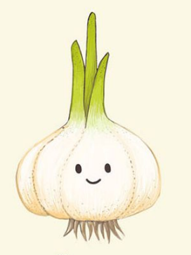
Resiliency Skills
(growing your onion)
What does your confidence look like?
How do you reclaim your confidence?
For me, it involves swearing and a pep talk (and becoming my best friend). ☺
Notes:
https://www.youtube.com/watch?v=1Evwgu369Jw

Slide 17
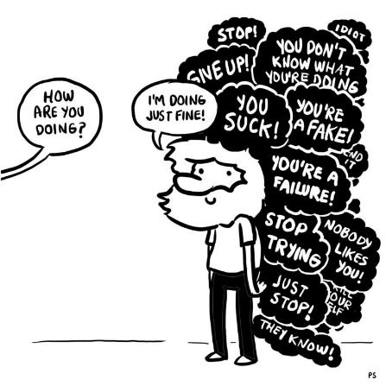
Resiliency Skills
(growing your onion)
life
Notes:
https://www.youtube.com/watch?v=1Evwgu369Jw

Slide 18
Resiliency Skills
(growing your onion) (radical empathy)
(growing your trusted advisers)
(leading with vulnerable courage)
Notes:
https://www.youtube.com/watch?v=1Evwgu369Jw

Slide 19
Resiliency Skills
(growing your onion) (radical empathy)
(growing your trusted advisers)
(leading with vulnerable courage)
Someone (multiple people) who:
Does the work you love.
Isn’t afraid to tell you to do better.
Shares your values.
Is much older.
Is much younger.
Notes:
https://www.youtube.com/watch?v=1Evwgu369Jw

Slide 20
Resiliency Skills
(growing your onion) (radical empathy)
(growing your trusted advisers)
(leading with vulnerable courage)
Can you have courage without vulnerability?
Notes:
https://www.youtube.com/watch?v=1Evwgu369Jw

Slide 21
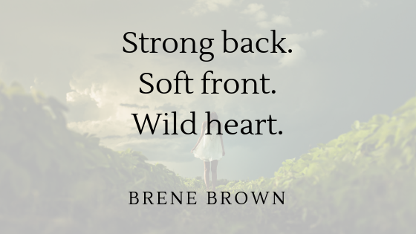
Resiliency Skills
(growing your onion) (radical empathy)
(growing your trusted advisers)
(leading with vulnerable courage)
Notes:
https://www.youtube.com/watch?v=1Evwgu369Jw

Slide 22
Resiliency Skills
(growing your onion) (radical empathy)
(growing your trusted advisers)
(leading with vulnerable courage)
Write down your hero
Write down 3 reasons (or words) why this person is your hero
Take a picture of it
Notes:
https://www.youtube.com/watch?v=1Evwgu369Jw

Slide 23
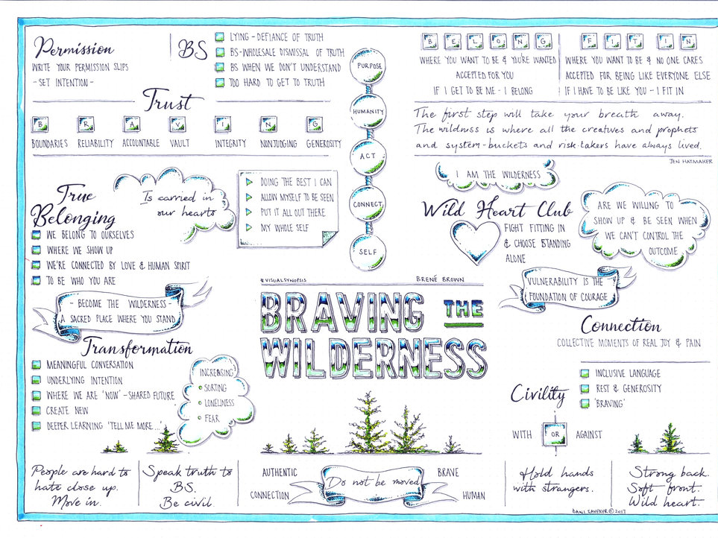

Slide 24
Notes:
https://the1a.org/segments/2017-09-12-brene-brown-the-quest-for-true-belonging-and-the-courage-to-stand-alone/
Musementorship.com
https://onbeing.org/programs/brene-brown-strong-back-soft-front-wild-heart/

